Slide 1

NAMMOORA PAYANA
Project By:
Sanjay SH
Srikanth DS
Pratyush Ranjan
Chirag R
Guided By :
Mrs. Roopa Shree C S

Slide 2
INTRODUCTION
Namma Karnataka is a land of colors, cultures, flavors, landscapes, timelessness and heart stopping beauty.
Nammoora Payana is a web application which will be helpful for the travelers in one point of go.
It provides the brief description about the places according to district and category wise.

Slide 3
OBJECTIVE
Many people don’t know the beautiful places Located in our Karnataka. People miss out the small places which gives a lot of joy.
It provides the brief description about the places according to district and category wise.

Slide 4
Problem Statement
To design and develop a website for reaching different places in a better way using html and java framework.

Slide 5
Motivation
Many places has been leftout without indicating in the google maps.
Cultural information of the region are not specified.

Slide 6
SOFTWARE AND PC REQUIREMENTS
Software requirements
Operating System: Windows, Mac or Linux
Developing Tool: Atom editor, Notepad
Front End: HTML, Java
Back End: JavaScript, CSS, PHP
Image processing: Photoshop
Pc for Development
Processor: Intel i3
RAM : 2GB RAM

Slide 7
Existing System
Less number of places and Images
No map representation.
No cultural Information
Some remote locations may not be available in the map.

Slide 8
PROPOSED SYSTEM Modules
Categories
Individual place.
Maps
Cultural Information
Attractive images (Gallery)

Slide 9
Database
Places Database
This database includes some of the images present within the place.
It even includes Feedback Form

Slide 10
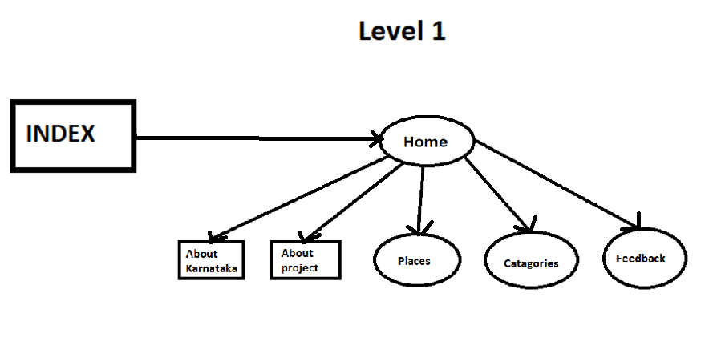
Data Flow Diagram

Slide 11
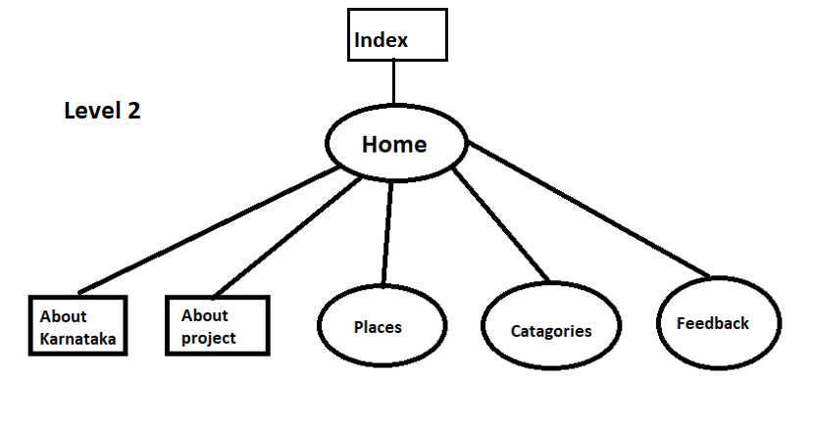
Data Flow Diagram

Slide 12
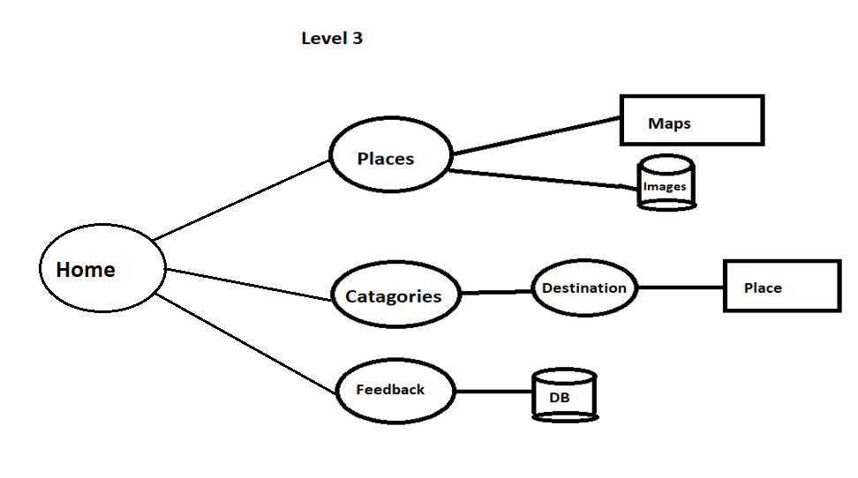
Data Flow Diagram

Slide 13
Future Enhancements
Kannada Language.
Travel Details
Accommodation
360° Images and videos.
Local tour Guide Details

Slide 14
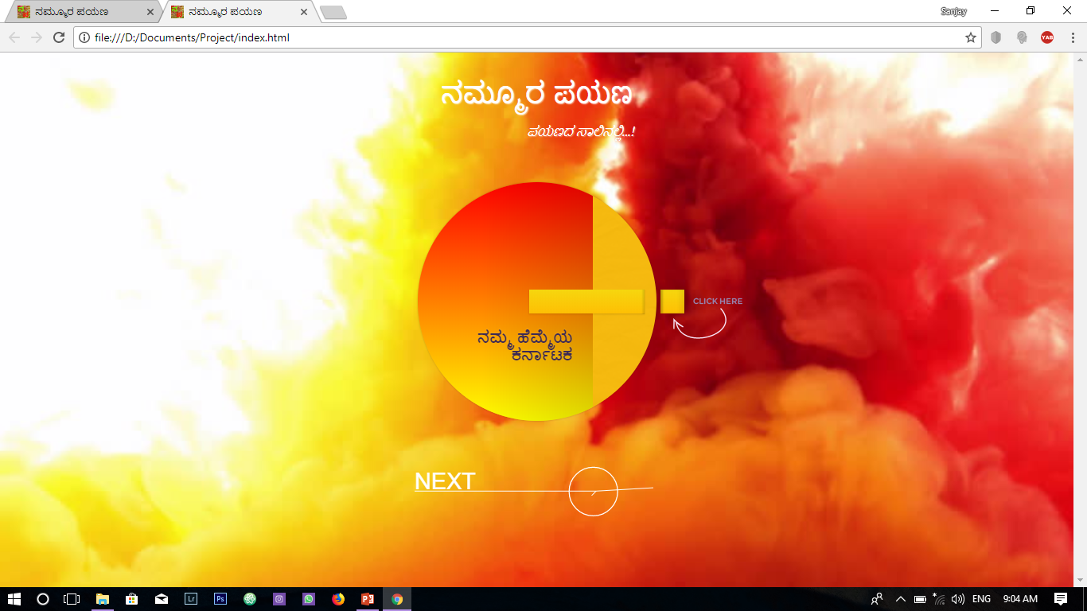

Slide 15
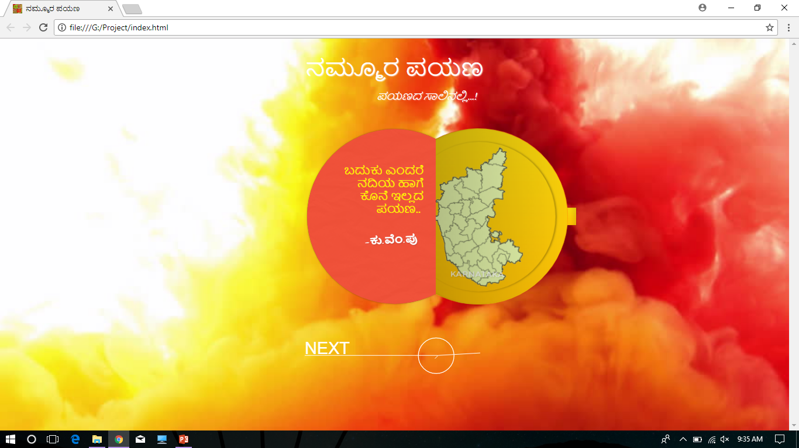

Slide 16
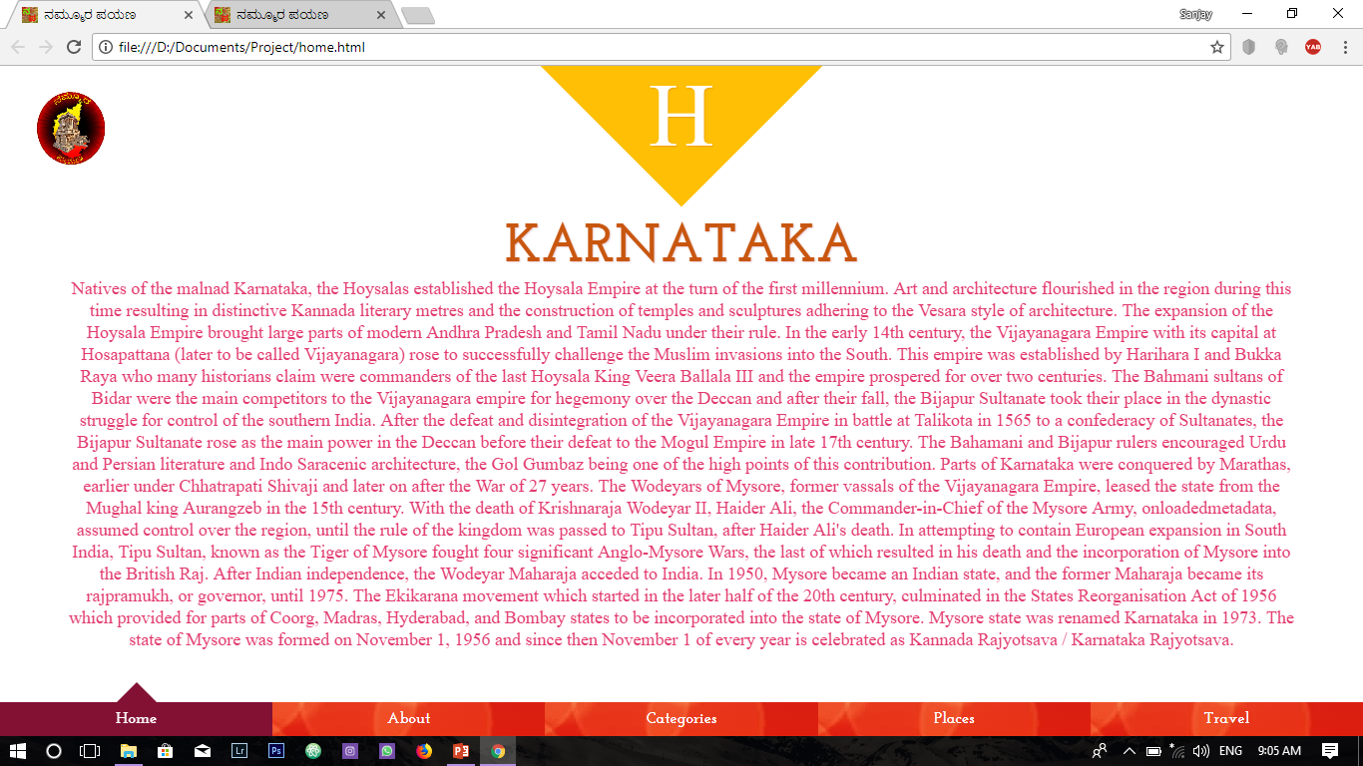

Slide 17
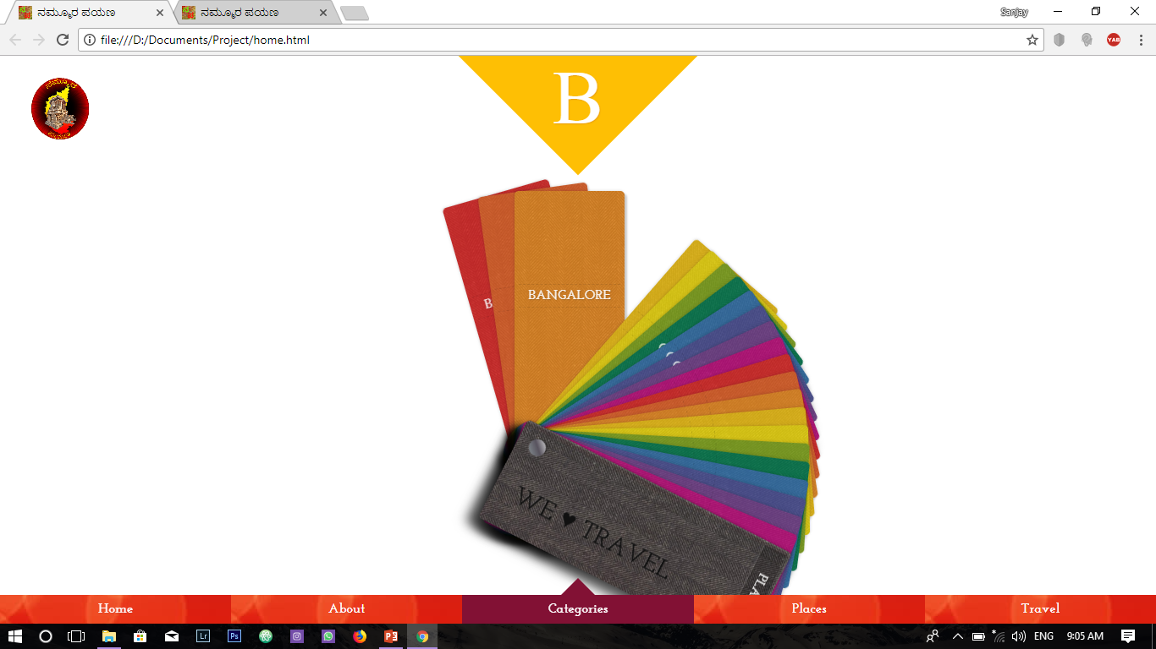

Slide 18
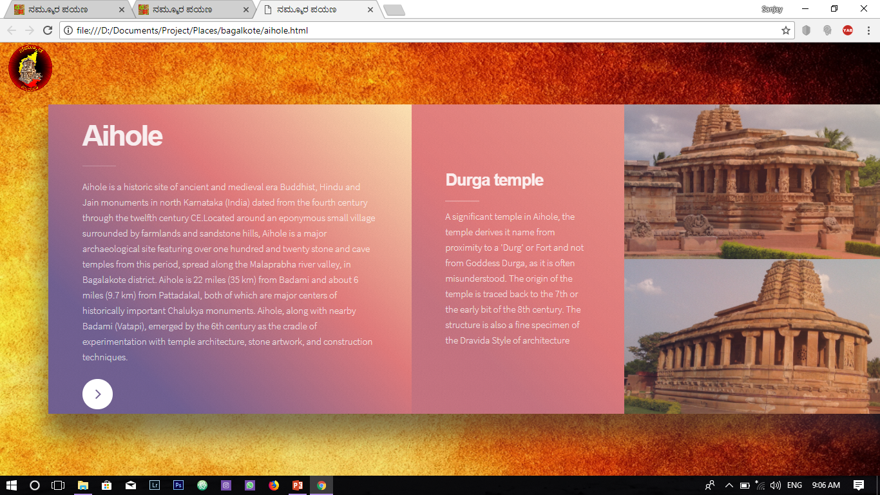

Slide 19
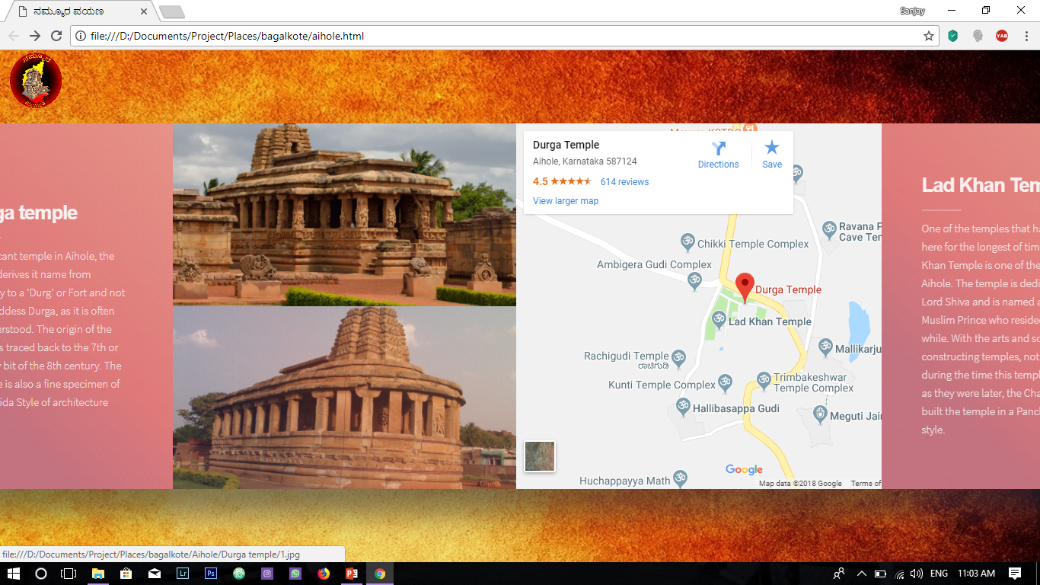

Slide 20
Conclusion
We provide the detailed description about the tourist places which are not aware to everyone. We provide the description about the destination places, directions from source to destination, nearby places along the destination.
The main goal of this project is to familiarize the unfamiliar places.

Slide 21
References
Maps
Wikipedia
Karnataka Tourism
Internet

Slide 22
Thank You
Project By:
Sanjay SH
Srikanth DS
Pratyush Ranjan
Chirag R

